Slide 1


Elliptic Curve Cryptography by Deeksha rao gorige & sumitha ravindran

Slide 2
Topics
Elliptic curves
Cryptography
Elliptic curve cryptography
Edward curves
Pollard’s rho algorithm
Advantages of rho algorithm
Methods implemented
Summary of results
references

Slide 3
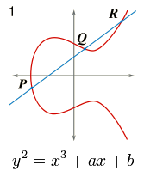
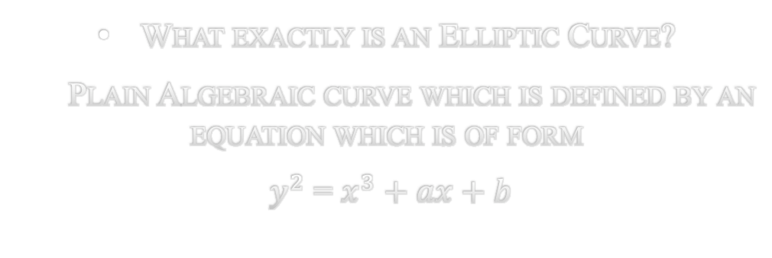
Introduction
What exactly is an Elliptic Curve?
Plain Algebraic curve which is defined by an equation which is of form
$y^{2}$ = $x^{3}+ax+b$

Slide 4
What Exactly is Cryptography?
Kryptos = “Hidden or Secret”
Graphein = “To write or Study”
Types of Cryptography –
Asymmetric Cryptography
Symmetric Cryptography

Slide 5
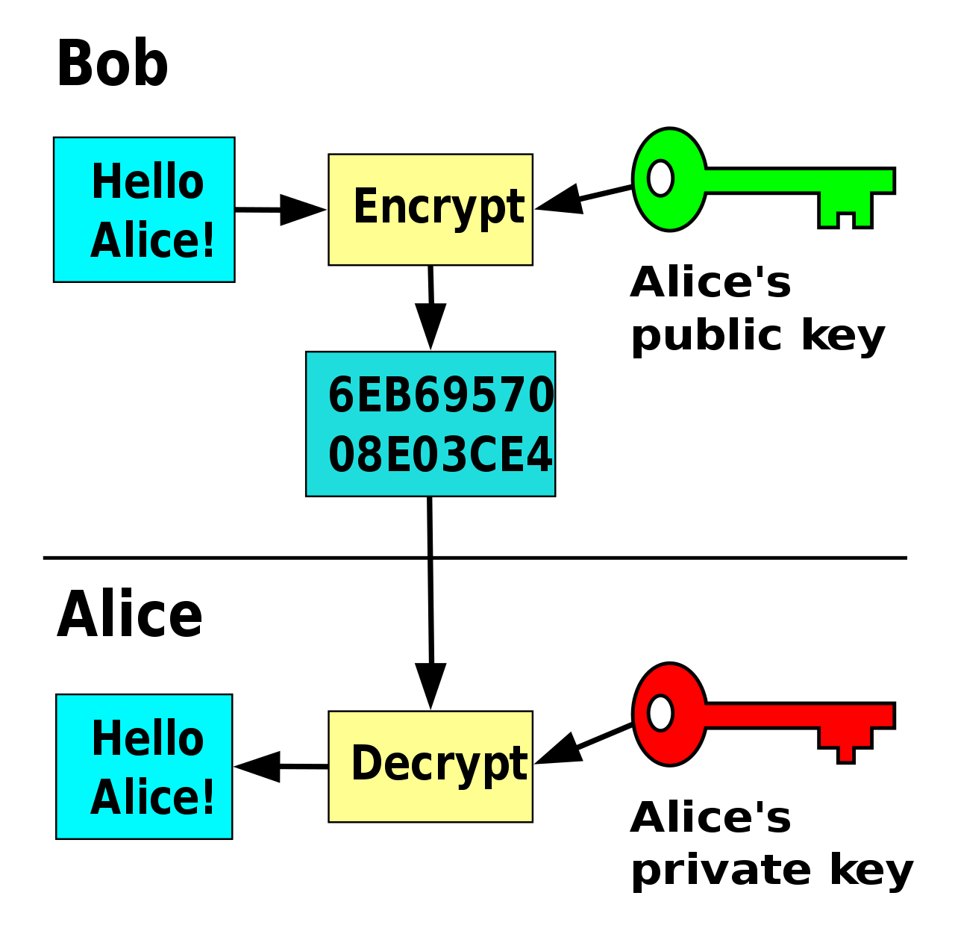
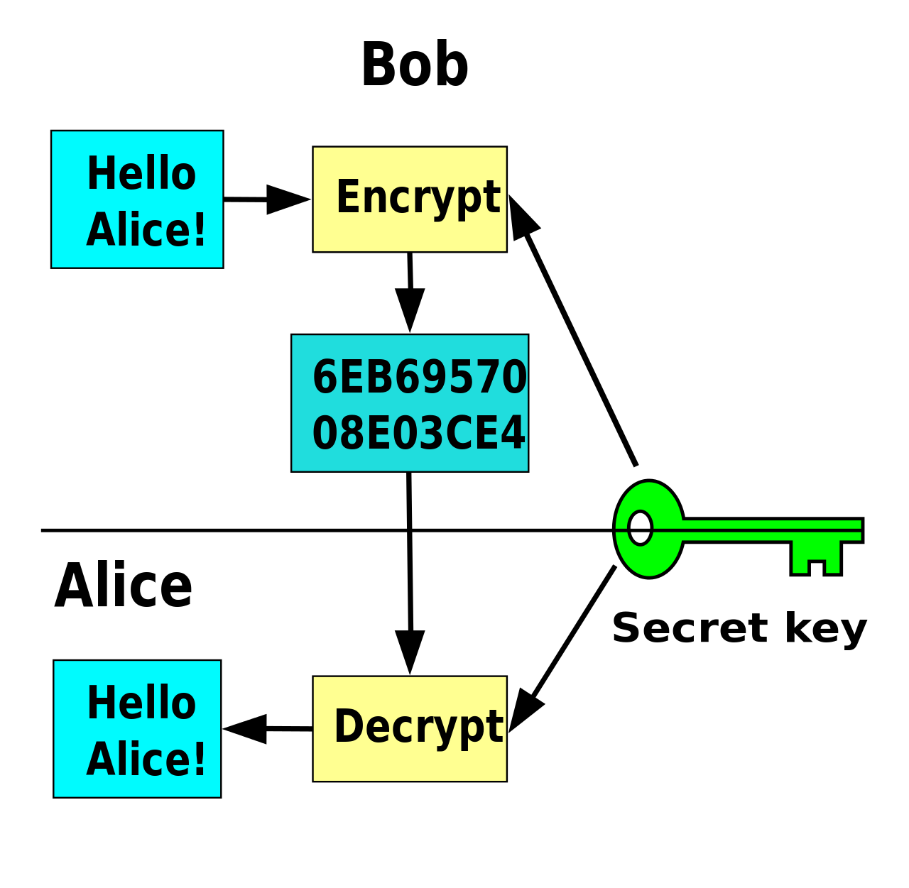
Asymmetric Cryptography
Symmetric Cryptography

Slide 6
Elliptic Curve Cryptography?
It is an approach to public-key Cryptography
Based on Elliptic curves

Slide 7
Benefits of elliptic curve cryptography
Key size
Cryptographic operations performance
Resource savings

Slide 8

Edward Curves
A FAMILY OF Elliptic curves
Equation of the form –
$x^{2}+ y^{2}=1+dx^{2}y^{2}$

Slide 9
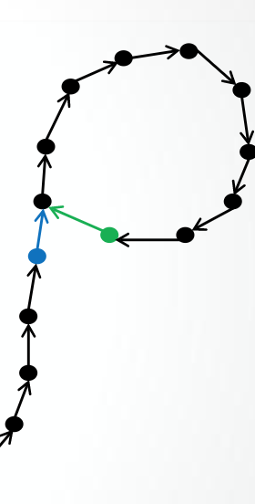
Pollard’s rho algorithm for elliptic curves
Algorithm to compute discrete logarithm problem
Idea – defining a sequence of elements that will periodically recurrent and then finding for a match in the sequence.
The match will lead to a solution of discrete logarithm problem .

Slide 10
Advantages of pollard’s rho algorithm
Efficient algorithm for finding the solution for discrete logarithm problem
the space requirements are small

Slide 11
applying Pollard’s rho algorithm to compute discrete logarithms on small elliptic curves-
Implemented methods-
Mul()
Exp()
Rho()
Check()

Slide 12
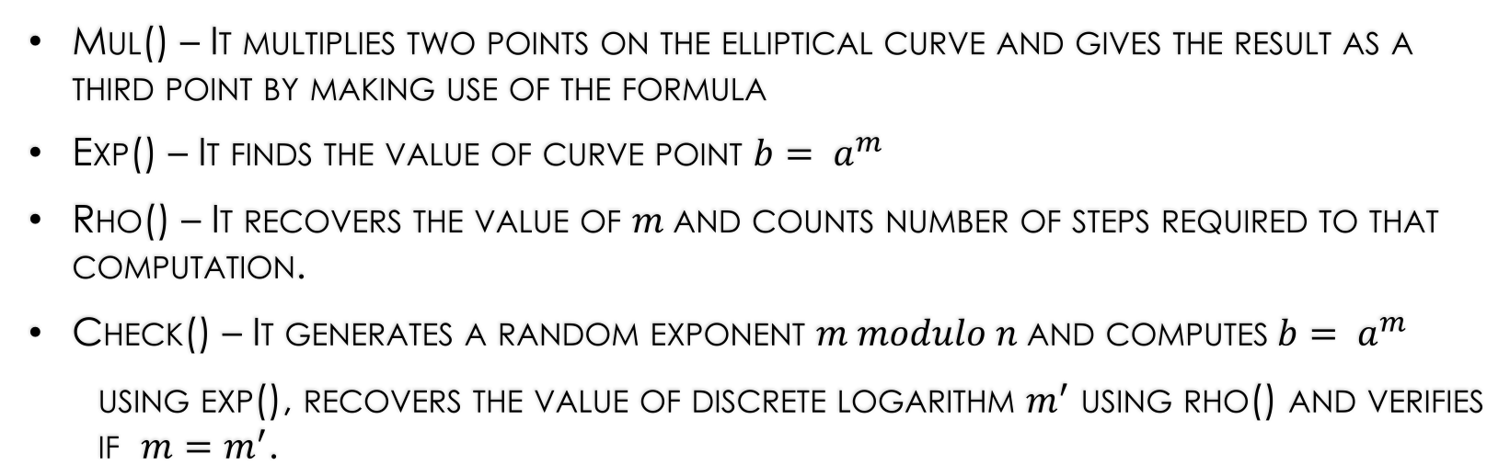
DESCRIPTION OF METHODS
Mul() – It multiplies two points on the elliptical curve and gives the result as a third point by making use of the formula
Exp() – It finds the value of curve point $b= a^{m}$
Rho() – It recovers the value of $m$and counts number of steps required to that computation.
Check() – It generates a random exponent $m modulo n$and computes$b= a^{m}$
using exp(), recovers the value of discrete logarithm $m^{′}$ using rho() and verifies if $m=m^{′}$.

Slide 13
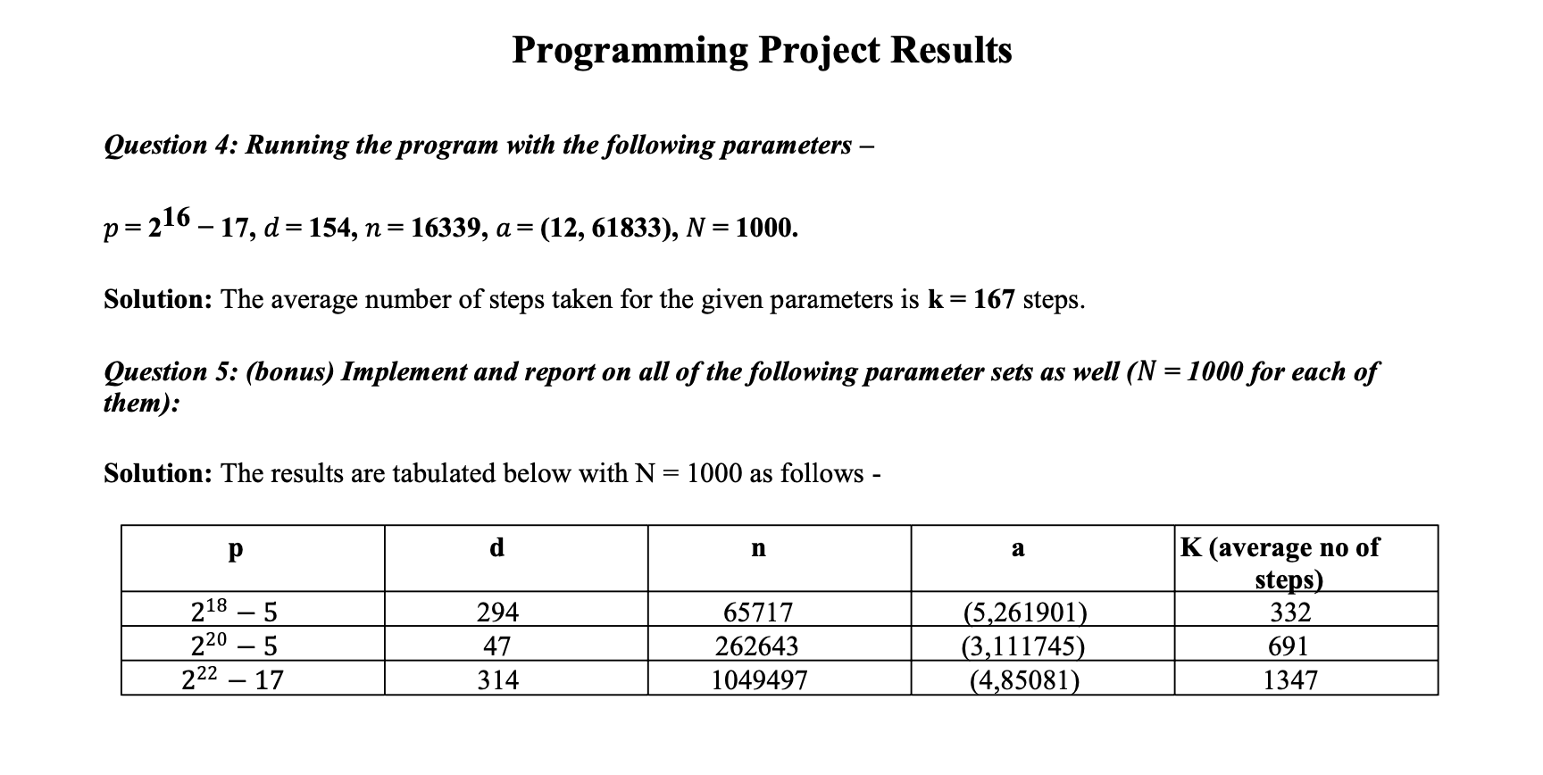
SUMMARY OF RESULTS

Slide 14
Conclusion
We have implemented the basic functionality of ecc and applied rho’s algorithm to compute the value of ‘m’ on small elliptic curves

Slide 15
References
https://www.youtube.com/watch?v=dCvB-mhkT0w&t=613s
https://www.hindawi.com/journals/jam/2012/635909/
http://ceur-ws.org/Vol-1548/032-Magons.pdf
https://www.sciencedirect.com/science/article/pii/S0377042712001392
https://www.maths.unsw.edu.au/sites/default/files/mandyseetthesis.pdf

Slide 16


Slide 17


